Slide 1
CS6456: Graduate Operating Systems
Brad Campbell – bradjc@virginia.edu
https://www.cs.virginia.edu/~bjc8c/class/cs6456-f19/

Slide 2
Operating systems in mobile contexts
Contexts:
Robots
Smartphones
Cars
What are the challenges?
Who are the users?
What is an application?
What guarantees are needed?

Slide 3
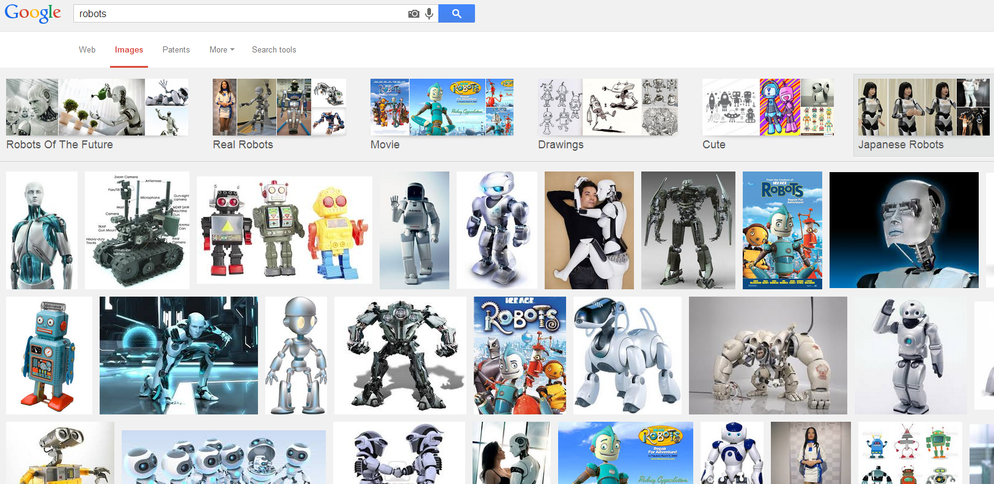
Pre 2007 for robots
Lack of standards for robotics

Slide 4

What is ROS?
ROS is an open-source robot operating system
A set of software libraries and tools that help you build robot applications that work across a wide variety of robotic platforms
Originally developed in 2007 at the Stanford Artificial Intelligence Laboratory and development continued at Willow Garage
Since 2013 managed by OSRF (Open Source Robotics Foundation)

Slide 5
ROS Main Features
ROS has two "sides"
The operating system side, which provides standard operating system services such as:
hardware abstraction
low-level device control
implementation of commonly used functionality
message-passing between processes
package management
A suite of user contributed packages that implement common robot functionality such as SLAM, planning, perception, vision, manipulation, etc.

Slide 6
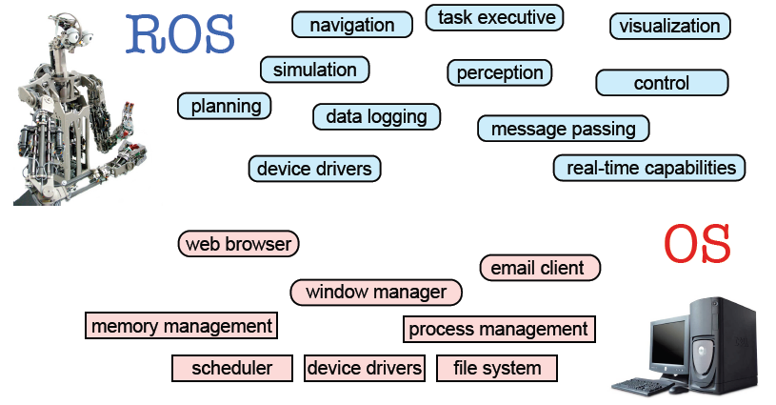
ROS Main Features
Taken from Sachin Chitta and Radu Rusu (Willow Garage)

Slide 7
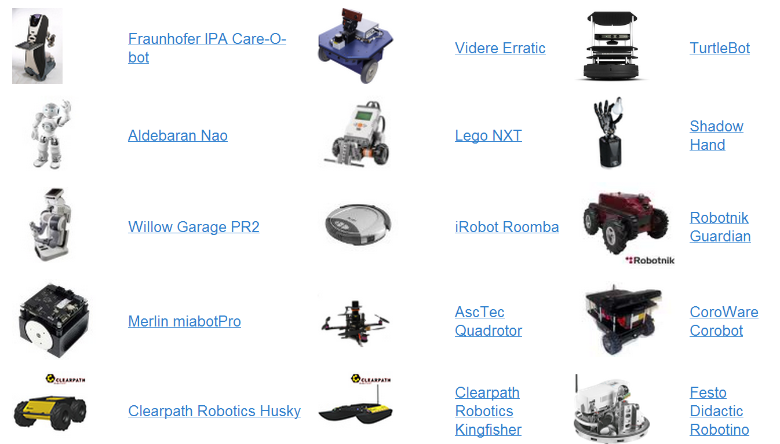
Robots using ROS
http://wiki.ros.org/Robots

Slide 8
ROS Philosophy
Peer to Peer
ROS systems consist of numerous small computer programs which connect to each other and continuously exchange messages
Tools-based
There are many small, generic programs that perform tasks such as visualization, logging, plotting data streams, etc.
Multi-Lingual
ROS software modules can be written in any language for which a client library has been written. Currently client libraries exist for C++, Python, LISP, Java, JavaScript, MATLAB, Ruby, and more.
Thin
The ROS conventions encourage contributors to create stand-alone libraries and then wrap those libraries so they send and receive messages to/from other ROS modules.
Free and open source

Slide 9
ROS Wiki
http://wiki.ros.org/
Installation: http://wiki.ros.org/ROS/Installation
Tutorials: http://wiki.ros.org/ROS/Tutorials
ROS Tutorial Videos
http://www.youtube.com/playlist?list=PLDC89965A56E6A8D6
ROS Cheat Sheet
http://www.tedusar.eu/files/summerschool2013/ROScheatsheet.pdf

Slide 10
ROS Core Concepts
Nodes
Messages and Topics
Services
ROS Master
Parameters
Stacks and packages

Slide 11
ROS Nodes
Single-purposed executable programs
e.g. sensor driver(s), actuator driver(s), mapper, planner, UI, etc.
Individually compiled, executed, and managed
Nodes are written using a ROS client library
roscpp – C++ client library
rospy – python client library
Nodes can publish or subscribe to a Topic
Nodes can also provide or use a Service

Slide 12
ROS Topics
A topic is a name for a stream of messages with a defined type
e.g., data from a laser range-finder might be sent on a topic called scan, with a message type of LaserScan
Nodes communicate with each other by publishing messages to topics
Publish/Subscribe model: 1-to-N broadcasting

Slide 13
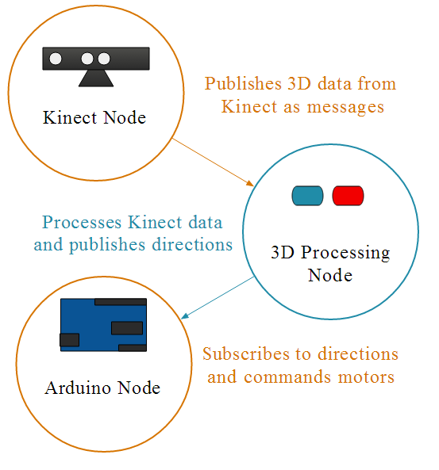
ROS Topics

Slide 14
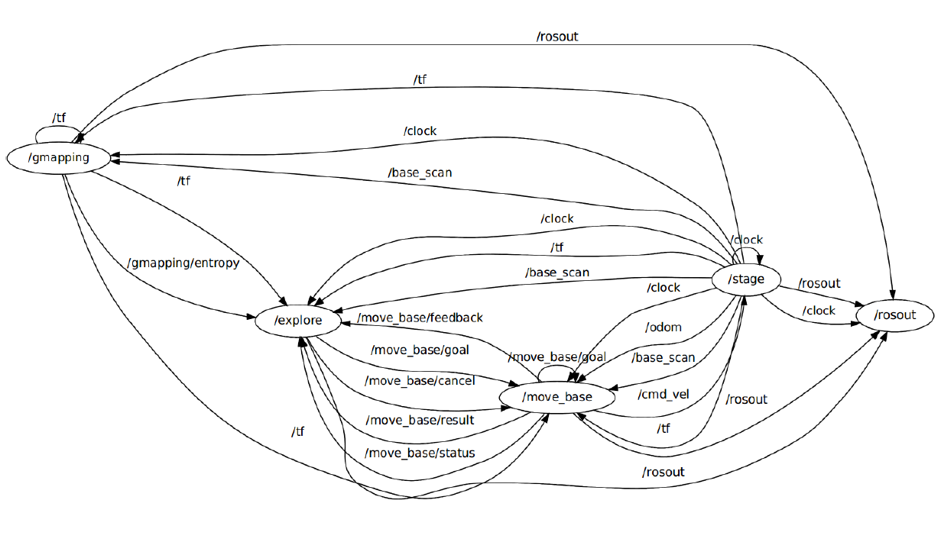
The ROS Graph

Slide 15
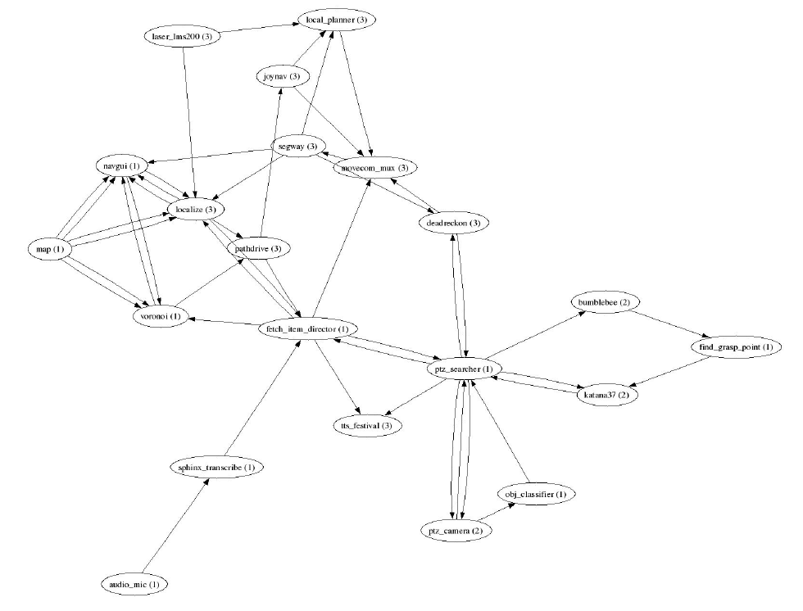
Fetch an Item Graph
Taken from Programming Robots with ROS (Quigley et al.)

Slide 16
ROS Messages
Strictly-typed data structures for inter-node communication
For example, geometry_msgs/Twist is used to express velocity commands:
Vector3 is another message type composed of:
Vector3 linear
Vector3 angular
float64 x
float64 y
float64 z

Slide 17
ROS Services
Synchronous inter-node transactions / RPC
Service/Client model: 1-to-1 request-response
Service roles:
carry out remote computation
trigger functionality / behavior
Example:
map_server/static_map – retrieves the current grid map used by the robot for navigation

Slide 18
ROS Master
Provides connection information to nodes so that they can transmit messages to each other
Every node connects to a master at startup to register details of the message streams they publish, and the streams to which that they to subscribe
When a new node appears, the master provides it with the information that it needs to form a direct peer-to-peer connection with other nodes publishing and subscribing to the same message topics

Slide 19
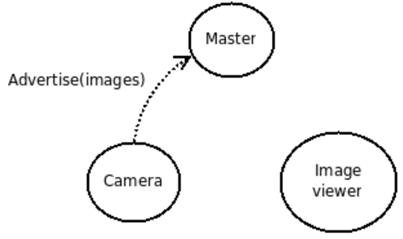
ROS Master
Let’s say we have two nodes: a Camera node and an Image_viewer node
Typically the camera node would start first notifying the master that it wants to publish images on the topic "images":

Slide 20
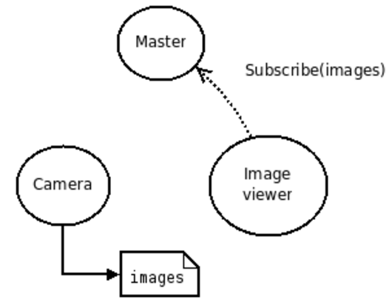
ROS Master
Now, Image_viewer wants to subscribe to the topic "images" to see if there's maybe some images there:

Slide 21
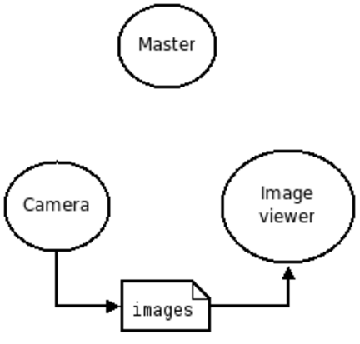
ROS Master
Now that the topic "images" has both a publisher and a subscriber, the master node notifies Camera and Image_viewer about each others existence, so that they can start transferring images to one another:

Slide 22
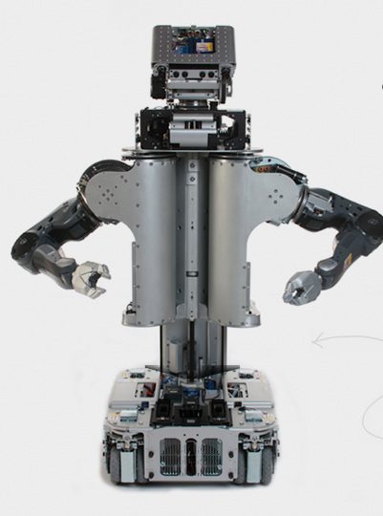
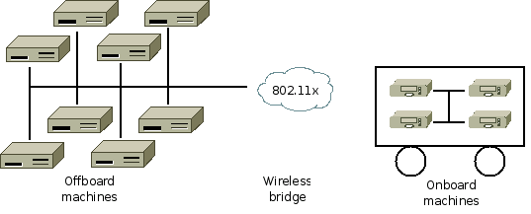
Peer to Peer Messaging
Master: Lookup information, think DNS
roscore command → starts master, parameter server, logging
Publish: Will not block until receipt, messages get queued.
Delivery Guarantees: Specify a queue size for publishers: If publishing too quickly, will buffer a maximum of X messages before throwing away old ones
Transport Mechanism: TCPROS, uses TCP/IP
Bandwidth: Consider where your data’s going, and how
Computation Graph
Notes:
TCPROS is a transport layer for ROS Messages and Services. It uses standard TCP/IP sockets for transporting message data. Inbound connections are received via a TCP Server Socket with a header containing message data type and routing information.

Slide 23
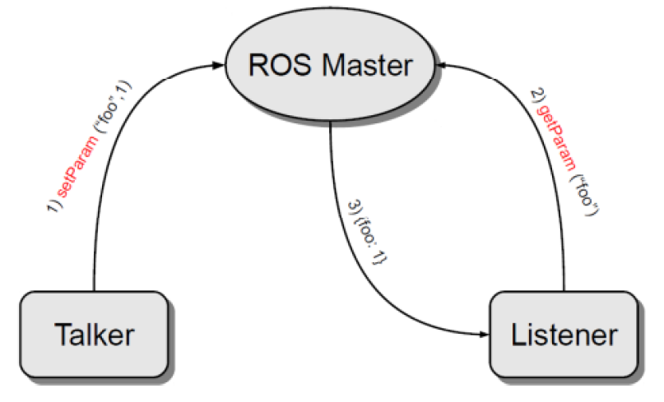
Parameter Server
A shared, multi-variate dictionary that is accessible via network APIs
Best used for static, non-binary data such as configuration parameters
Runs inside the ROS master

Slide 24
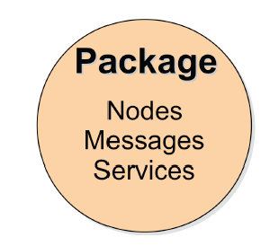
ROS Packages
Software in ROS is organized in packages.
A package contains one or more nodes and provides a ROS interface
Most of ROS packages are hosted in GitHub

Slide 25
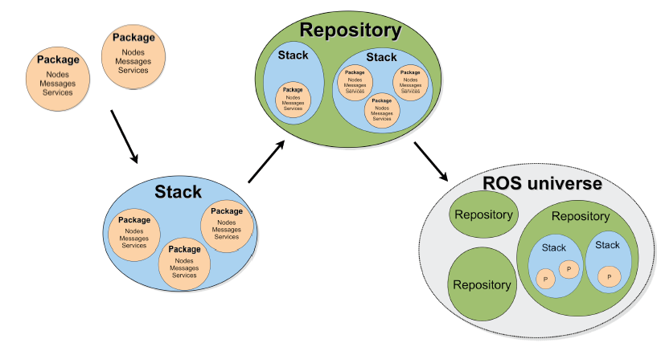
ROS Package System
Taken from Sachin Chitta and Radu Rusu (Willow Garage)

Slide 26
ROS key concepts
Need coordination between a broad set of components
Components can run on different machines
Optimized communication peer-to-peer
Users: just one
Processes: many small components

Slide 27
Android: mobile phone OS

Slide 28
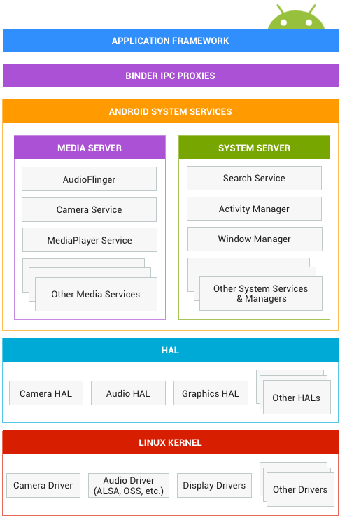
Android Interfaces and Architecture

Slide 29



Android Fundamentals
What kind of an OS is Android?
User ID1
User ID2
Android OS
A multi-user Linux system
(classroom.cs.unc.edu)
Notes:
Android OS is a multi-user Linux system.
Each app is like a different user (unique user ID).
Each app lives in its own security sandbox.
Every app runs in its own Linux process.
Android starts/terminates the process based on the need for an app's components to be executed.

Slide 30
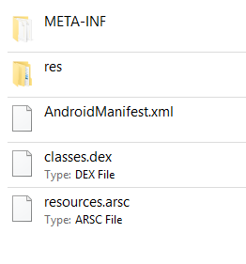
Android Fundamentals
What is an APK file?
Android SDK tools compile your java source files into .dex files, and then zip .dex file, project resources (images, layouts etc.) and the manifest file into an APK.
Unzip any android .apk and you will see these files inside it. You can find an .apk file inside: YourProject/app/build/outputs/apk
Note: You need to Build .apk from Android Studio at least once to see the apk folder in your laptop.

Slide 31
Android Fundamentals
What is ART?
ART = Android Runtime (it’s like Java Runtime)
Pros: Faster application execution.
Cons: Longer installation time, more storage requirement.
ART
DEX
dex2oat
native code
ART runtime
AOT (ahead of time) compilation
i.e. when an app is installed

Slide 32
The Manifest File
Configuration interface between processes and the OS
AndroidManifest.xml – we must declare all the app components (i.e., activity, service etc.) in this file.
This file also contains:
Permissions (e.g., location, storage etc.)
API Level (min and target)
HW/SW features used
Other API libraries

Slide 33
The Manifest File
<activity> elements for activities
<service> elements for services
<provider> elements for content providers
<receiver> elements for broadcast receivers
Activities, services, and content providers that you include in your source but do not declare in the manifest are not visible to the system and, consequently, can never run.
Broadcast receivers can be either declared in the manifest or created dynamically in code (as BroadcastReceiver objects) and registered with the system by calling registerReceiver().

Slide 34
Interface comparison Linux vs. Android

Slide 35
Four Types of App Components
Activity
Service
Content Provider
Broadcast Receiver
Activity
Activity
Activity
Service
Content
Provider
Activity
Broadcast Receiver
Broadcast Receiver
Broadcast Receiver
An Example APP

Slide 36
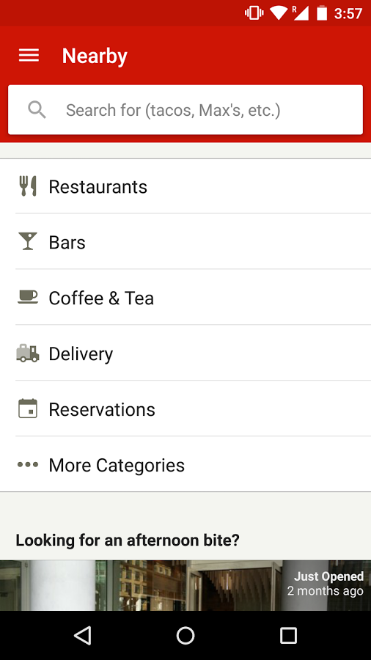
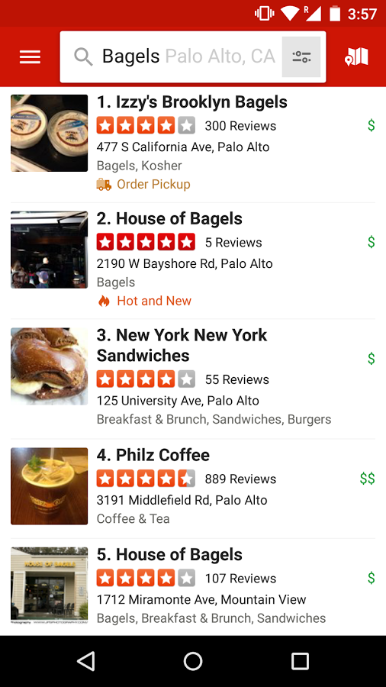
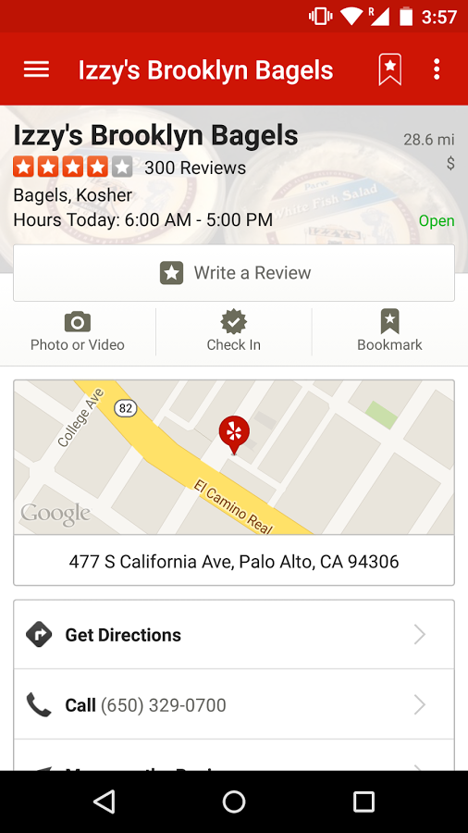
1. Activity
An activity represents a single screen with a user interface.

Slide 37
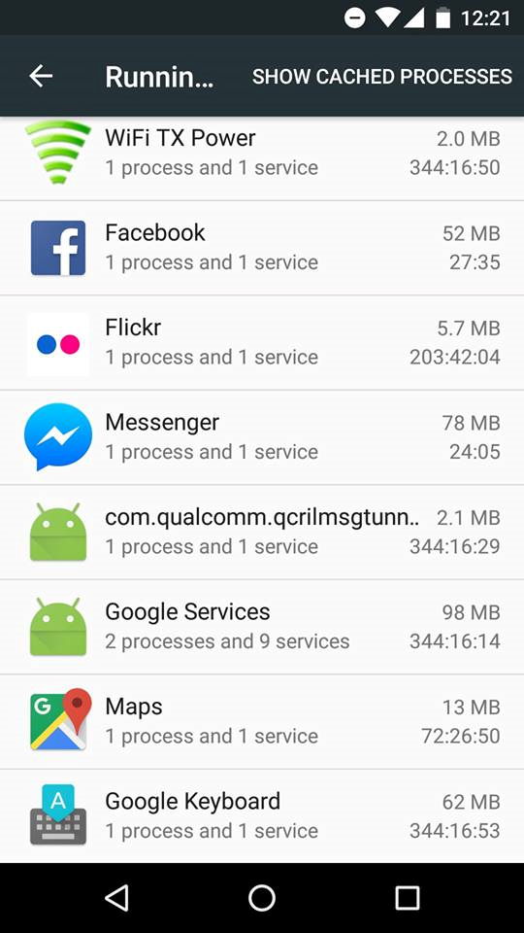
2. Service
Runs in the background to perform long running operations, or does some work for remote processes.
A service does not provide a user interface.
Yes, you can create your own services too.
Settings>Developer Options>Running Services

Slide 38
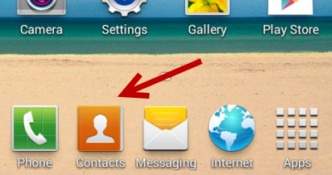
3. Content Provider
A content provider manages a shared set of app data.
Other apps can query or even modify the data.
You can store the data in the file system, an SQLite database, on the web, or any other persistent storage location your app can access.

Slide 39
4. Broadcast Receiver
A broadcast receiver is a component that responds to system-wide broadcast announcements.
Originate from the system—the battery is low, or a picture was captured.
Initiated by an App – download completed.
Broadcast receivers don't display a user interface, they may create a status bar notification.

Slide 40
Multiple Entry Points
One component can start another component
Another
App
Activity
Activity
Activity
User
Service
Content
Provider
Activity
Another
App
Broadcast Receiver
Broadcast Receiver
Broadcast Receiver
Another
App
An Example APP

Slide 41
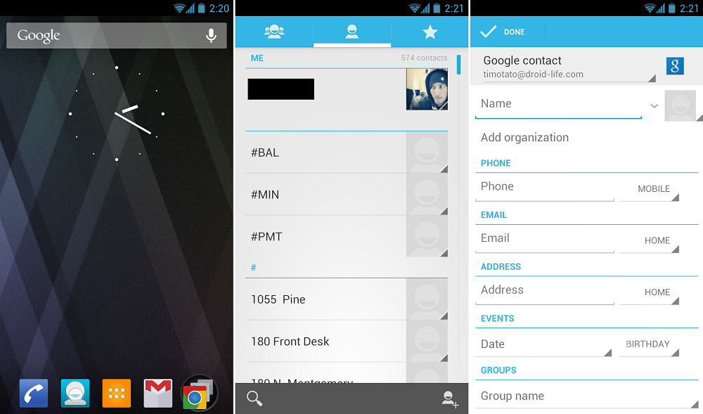
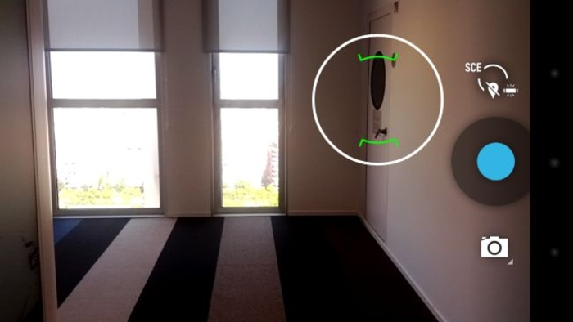
Example
One component can start another component

Slide 42
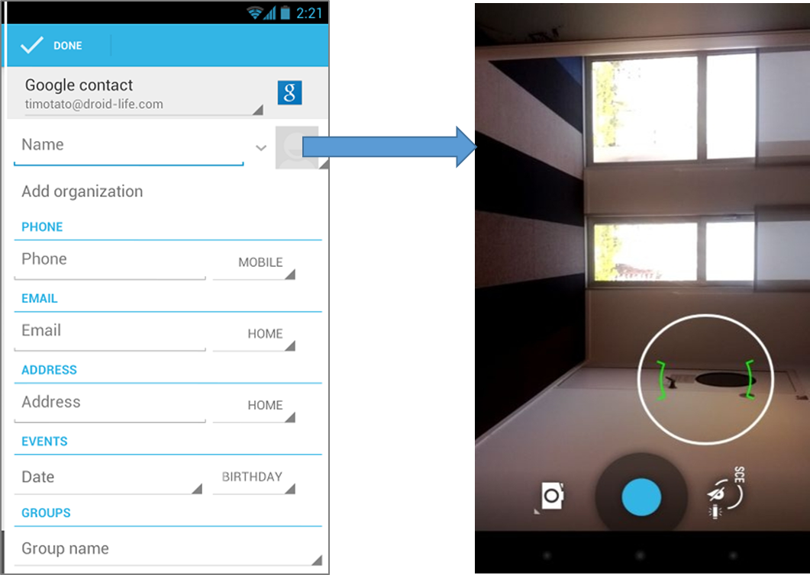
“Intent”: Activating components
Three of the four component types—activities, services, and broadcast receivers—are activated by an asynchronous message called an intent.
Intents bind individual components to each other at runtime.
Intent

Slide 43
“Intent”: Activating Component
You can start an activity (or give it something new to do) by passing an Intent to startActivity() or startActivityForResult() (when you want the activity to return a result).
You can start a service (or give new instructions to an ongoing service) by passing an Intent to startService(). Or you can bind to the service by passing an Intent to bindService().
You can initiate a broadcast by passing an Intent to methods like sendBroadcast(), sendOrderedBroadcast(), or sendStickyBroadcast().
You can perform a query to a content provider by calling query() on a ContentResolver.

Slide 44
Explicit Intents
Explicit – using the component’s class name.
Activity1
Intent x = new Intent(this, Activity2.class);
startActivity(x);
Activity2

Slide 45
Explicit Intent Example – with data
We want to switch to an Activity and pass some data to it.
Activity1
Intent X = new Intent(this, Activity2.class);
X.setData(“some Uri”);
startActivity(X);
Activity2
To access the data in the other Activity:
“getIntent().getData()”

Slide 46




Explicit Intent vs. Implicit Intent
Mr. Thor, can I have your hammer?
Who can share a hammer, please?
I can
I need HAMMER
Android OS

Slide 47
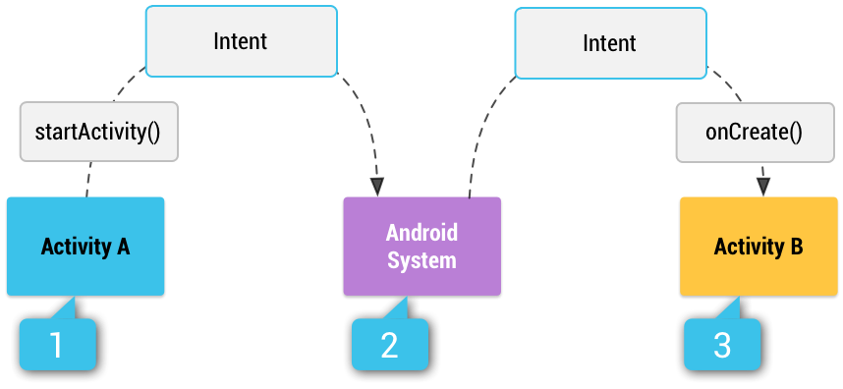
Implicit Intents
Implicit – using some reserved keywords.
You provide type of action to be performed
You can provide data to be used
Multiple matching Activities may exist.

Slide 48
Implicit Intent Example
We want to VIEW a webpage in a browser:
Intent w = new Intent(
Intent.ACTION_VIEW, Uri.parse(“http://www.unc.edu”)
);

Slide 49
Another Implicit Intent Example
We want to VIEW a location on a map:
Intent w = new Intent(
Intent.ACTION_VIEW,
Uri.parse(“geo:35.909715, -79.052779?Z=14”)
);

Slide 50
What if no one to receive my Intent?
Your App will crash!
To get a list of matching Apps:
To verify that the Intent will resolve to an Activity:
getPackageManager().queryIntentActivities(
your_intent,
PackageManager.MATCH_DEFAULT_ONLY
);
X.resolveActivity(getPackageManager()) != null

Slide 51
Getting Results Back
We want an Activity to do something and return the result back to us.
Step1:
startActivityForResult(intent_object, SOME_REQ_CODE);
Step2:
@Override
protected void onActivityResult (int requestCode, int resultCode, Intent data)
{
}

Slide 52
Example: Implicit Intent with Camera
Intent w = new Intent(MediaStore.ACTION_IMAGE_CAPTURE);
startActivity(w);

Slide 53
Getting the Image Back
Intent w = new Intent(MediaStore.ACTION_IMAGE_CAPTURE);
startActivityForResult(w, 1);
@Override
protected void onActivityResult(int requestCode, int resultCode, Intent x)
{
//if (requestCode == 1 && resultCode == RESULT_OK)
{
Bundle extras = x.getExtras();
Bitmap imageBitmap = (Bitmap) extras.get("data");
img = (ImageView) findViewById(R.id.imageView);
img.setImageBitmap(imageBitmap);
}
}

Slide 54
How to receive an Intent?
Suppose, your App can send or share a text.
Other
Activity
ACTION_SEND
Your
Activity
Plain text
<intent-filter>
<action android:name="android.intent.action.SEND"/> <category android:name="android.intent.category.DEFAULT"/> <data android:mimeType="text/plain"/>
</intent-filter>
You must include the CATEGORY_DEFAULT to receive implicit intents.

Slide 55
How to receive an Intent?
You specify <intent-filter> in your manifest.
Other
Activity
ACTION_MAIN
Your
Activity
LAUNCHER
<activity android:name="MainActivity"> <!-- This activity is the main entry, should appear in app launcher --> <intent-filter> <action android:name="android.intent.action.MAIN" /> <category android:name="android.intent.category.LAUNCHER" /> </intent-filter> </activity>

Slide 56
Android key points
High-level IPC (intents) provided by the OS
Apps run isolated as separate processes and users
Comparison with ROS?

Slide 57
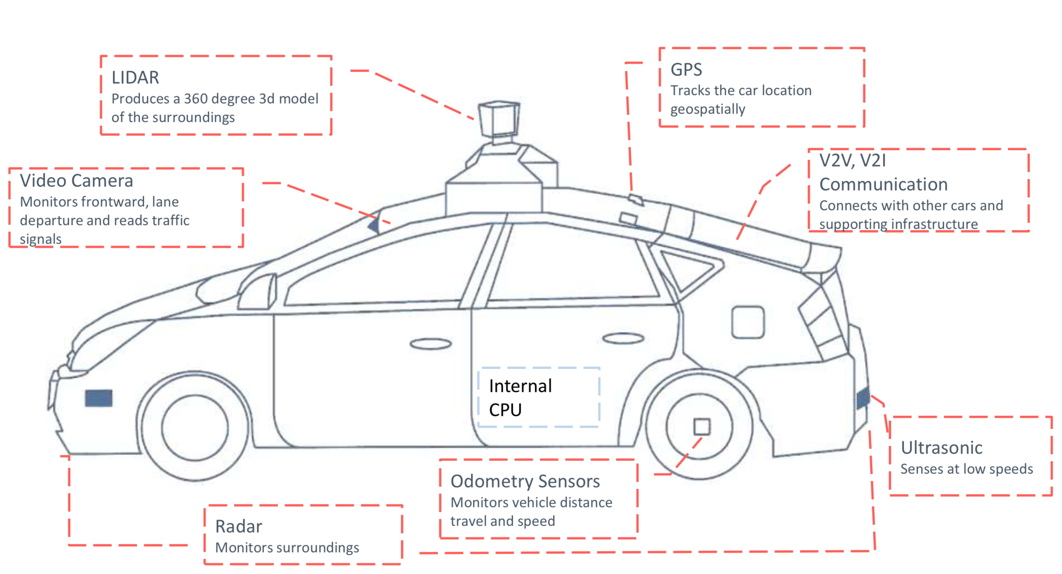
Autonomous Vehicles: What would an OS look like?

